Slide 1



Activating domestic tourism

Slide 2
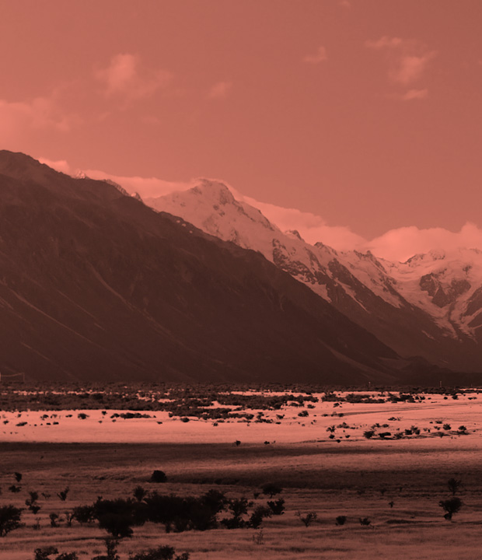
6,000 online interviews with New Zealanders about their domestic tourism behaviour and intentions.
All interviewing done in September 2016.
THE RESEARCH
IS BASED ON
Sample structured to be representative of the New Zealand population by age, gender, and region.

Slide 3

WHEN WE SAY DOMESTIC TOURISM,
WHAT WE ACTUALLY MEAN IS…
Domestic travel for leisure reasons which involves either:
5
OR
HOURS
At least one night away from home
At least five hours away from home and a tourist activity

Slide 4
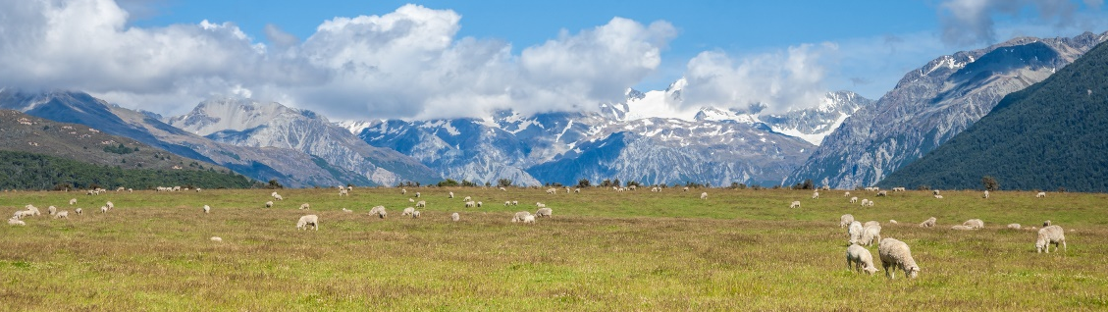
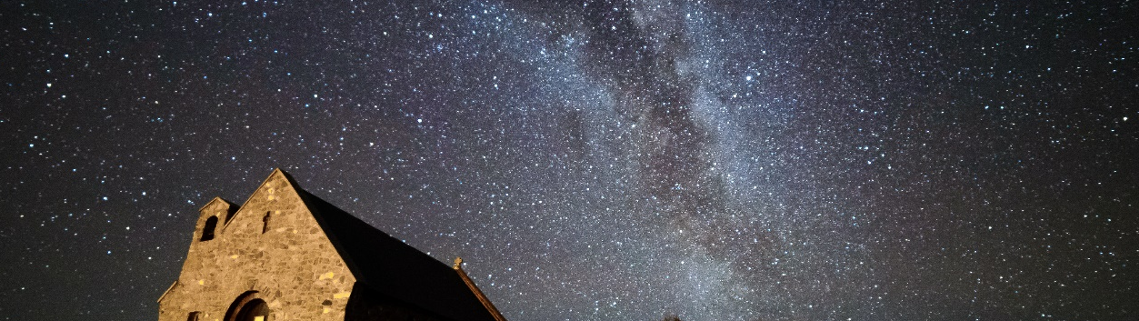
DAY TRIPS
27,565,000
of these in the last 12 months
OVERNIGHT TRIPS
17,443,000
of these in the last 12 months

Slide 5
There is strong inherent interest in some regions, while others will need to work hard to attract visitors
For a short break
For a long break
(2 to 3 nights)
(5+ nights)
HIGH INTEREST
LOW INTEREST
HIGH INTEREST
LOW INTEREST

Slide 6
Interest in a region varies hugely depending on where someone comes from
Origin of those interested in Wellington
Origin of those interested in Central Otago
HIGH INTEREST
LOW INTEREST
HIGH INTEREST
LOW INTEREST

Slide 7
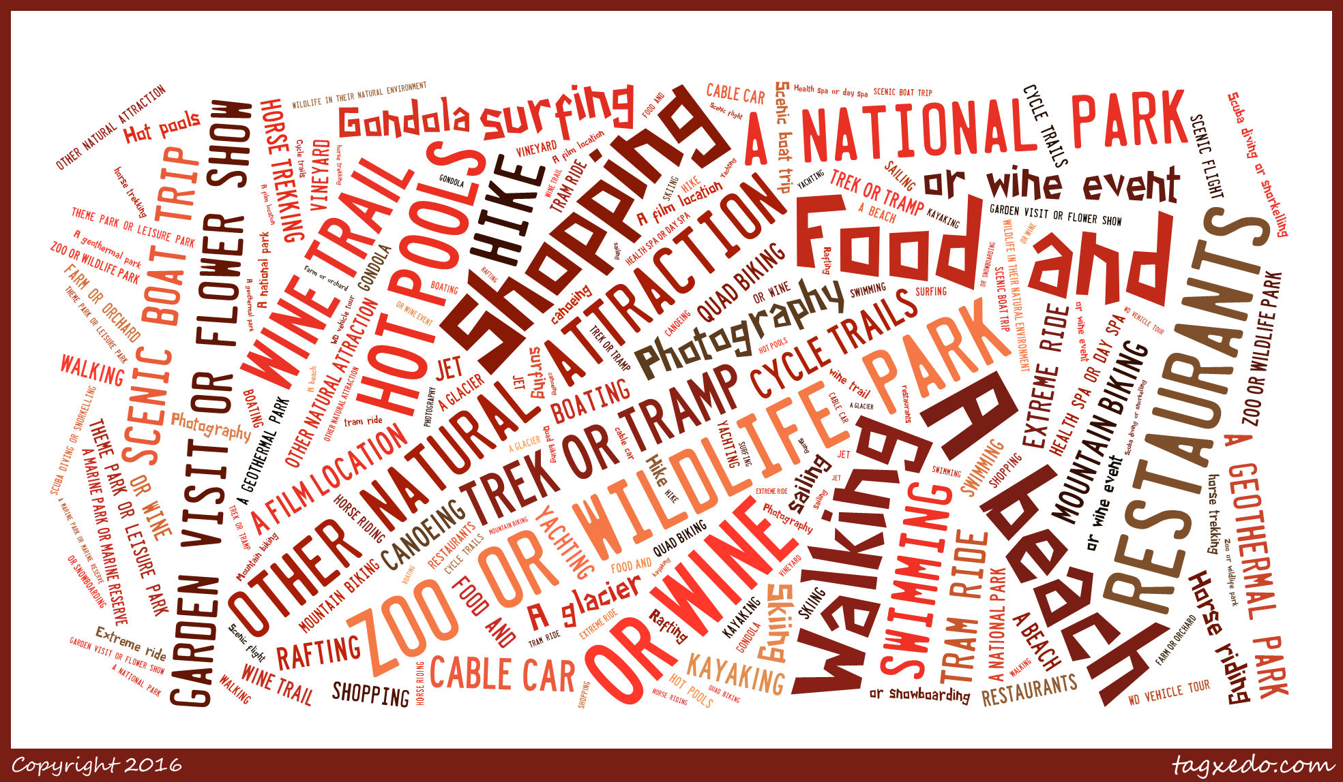
We assessed interest in 63 activities
The larger the word(s) the greater the interest.

Slide 8

01
CASE STUDY
DECIDING TO START A BUSINESS
Joe is thinking about setting up a water based adventure tourism business and wants to know whether it is viable.

Slide 9
01
CASE STUDY
The best place to base his business
DGiT WOULD TELL JOE…
(map shows where his market already want to go and where they can get to easily)
That there is definitely a decent sized market for his business
541,000
Overnight trips are taken every year by New Zealanders interested in rafting, canoeing or kayaking
HIGH VOLUME
LOW VOLUME

Slide 10
01
How to position his business
CASE STUDY
(People’s motivations for water based activities aren’t so much about the adventure or challenge, they are more about exploring the outdoors and discovering new things or places)
DGiT WOULD TELL JOE…

Slide 11
Returning to the overall results, people plan using a wide range of tools

Slide 12
There are three main triggers for domestic tourism

Slide 13
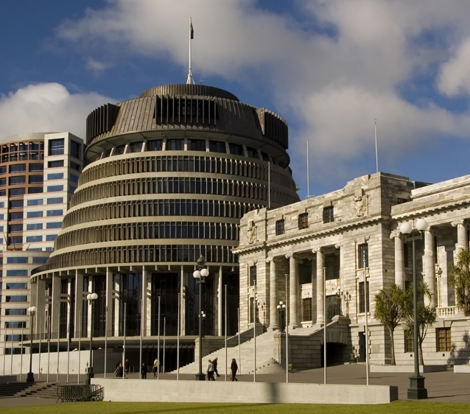
02
CASE STUDY
ATTRACTING PEOPLE TO A REGION
The Wellington regional tourism organisation wants to attract more weekend visits to Wellington in the winter

Slide 14
02
CASE STUDY
DGiT WOULD TELL THE WELLINGTON RTO…
That attending a specific event is an important trigger for people already interested in Wellington
That there is most interest in live music events, sports events and wine/food events

Slide 15
02
CASE STUDY
DGiT WOULD TELL THE WELLINGTON RTO…
That Facebook and TV are best media to reach the target audience
To target people from Auckland, Hawkes Bay, and Canterbury because these people are most likely to come to Wellington for an event.
HIGH VOLUME
LOW VOLUME

Slide 16

03
CASE STUDY
ATTRACTING A BROADER CUSTOMER BASE
Jill operates a backpackers in Taranaki and most of her New Zealand customers are 18 to 34 – she wants to know what she has to do to attract more 35 to 49 year olds.

Slide 17
03
CASE STUDY
DGiT WOULD TELL JILL…
The accommodation preferences of 35 to 49 year olds who are interested in visiting Taranaki
The websites her target market use to book travel – so she knows the key ones to have a listing on

Slide 18
03
CASE STUDY
DGiT WOULD TELL JILL…
That relaxing and escaping stress is an important motivation which will help her shape the way she describes her backpackers in the listings
The types of activities they want to do on holiday, which will help her decide on the Google AdWords to invest in

Slide 19
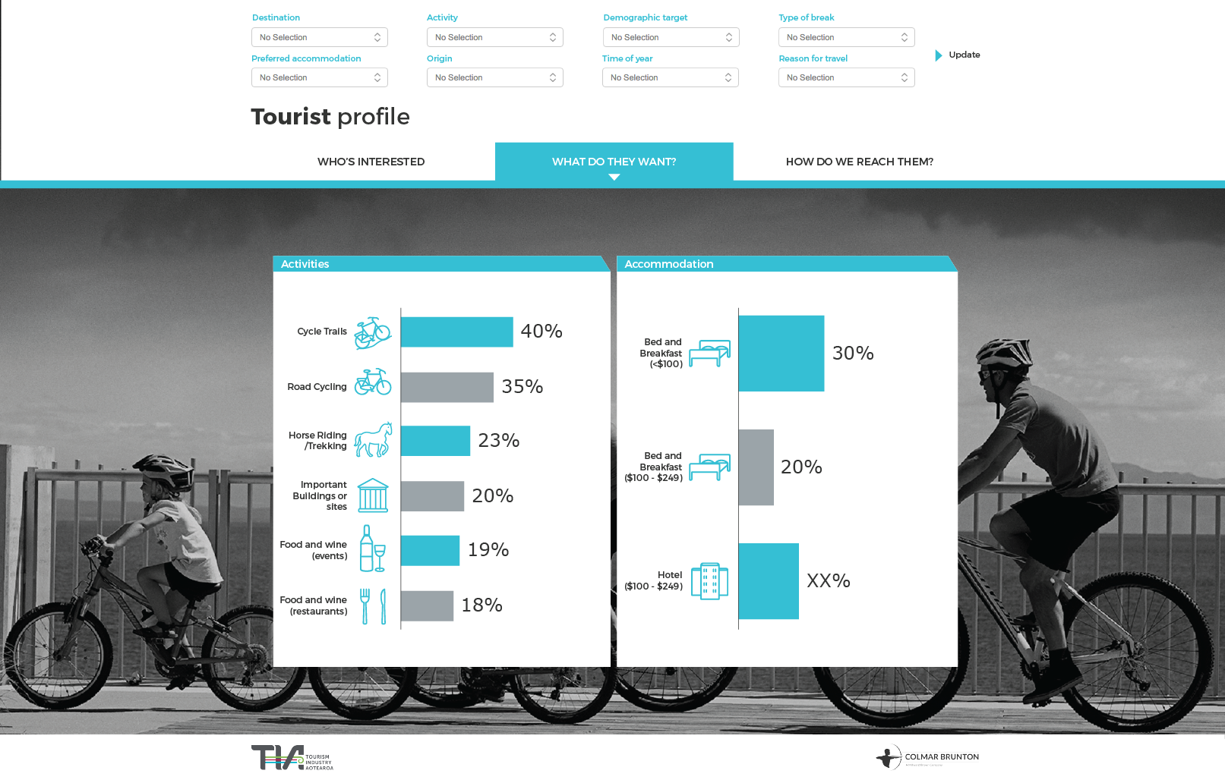
INTRODUCING
DGiT
Photo credit: Destination Great Lake Taupo

